Slide 1
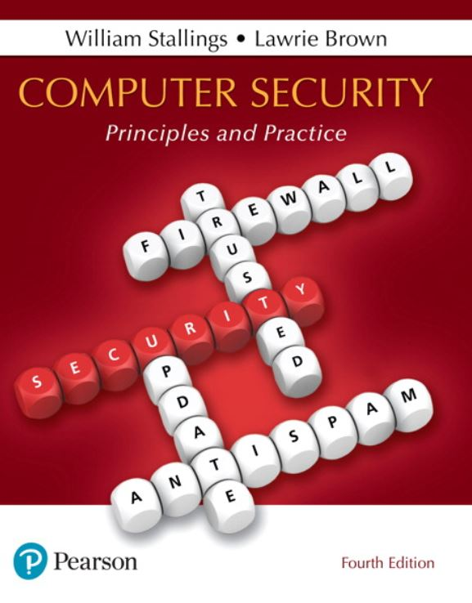

Computer Security: Principles and Practice
Fourth Edition
Chapter 9
Firewalls and Intrusion Prevention Systems
Copyright © 2018, 2015, 2012 Pearson Education, Inc. All Rights Reserved
Notes:
If this PowerPoint presentation contains mathematical equations, you may need to check that your computer has the following installed:
1) MathType Plugin
2) Math Player (free versions available)
3) NVDA Reader (free versions available)
Firewalls can be an effective means of protecting a local system or network of systems from network-based security threats while at the same time affording access to the outside world via wide area networks and the Internet.
Information systems in corporations, government agencies, and other organizations have undergone a steady evolution. The following are notable developments:
• Centralized data processing system, with a central mainframe supporting a number of directly connected terminals
• Local area networks (LANs) interconnecting PCs and terminals to each other and the mainframe
• Premises network, consisting of a number of LANs, interconnecting PCs, servers, and perhaps a mainframe or two
• Enterprise-wide network, consisting of multiple, geographically distributed premises networks interconnected by a private wide area network (WAN)
• Internet connectivity, in which the various premises networks all hook into the Internet and may or may not also be connected by a private WAN
• Enterprise cloud computing, which we will describe further in Chapter 13, with virtualized servers located in one or more data centers that can provide both internal organizational and external Internet accessible services.

Slide 2
The Need For Firewalls
Internet connectivity is essential
However it creates a threat
Effective means of protecting L A Ns
Inserted between the premises network and the Internet to establish a controlled link
Can be a single computer system or a set of two or more systems working together
Used as a perimeter defense
Single choke point to impose security and auditing
Insulates the internal systems from external networks
Notes:
Internet connectivity is no longer optional for organizations. The information and services available are essential to the organization. Moreover, individual users within the organization want and need Internet access, and if this is not provided via their LAN, they could use a wireless broadband capability from their PC to an Internet service provider (ISP). However, while Internet access provides benefits to
the organization, it enables the outside world to reach and interact with local network assets. This creates a threat to the organization. While it is possible to equip each workstation and server on the premises network with strong security features, such as intrusion protection, this may not be sufficient and in some cases is not cost effective. Consider a network with hundreds or even thousands of systems, running
various operating systems, such as different versions of Windows, MacOS, and Linux. When a security flaw is discovered, each potentially affected system must be upgraded to fix that flaw. This requires scaleable configuration management and aggressive patching to function effectively. While difficult, this is possible and is necessary if only host-based security is used. A widely accepted alternative or at least
complement to host-based security services is the firewall. The firewall is inserted between the premises network and the Internet to establish a controlled link and to erect an outer security wall or perimeter. The aim of this perimeter is to protect the premises network from Internet-based attacks and to provide a single choke point where security and auditing can be imposed. The firewall may be a single computer
system or a set of two or more systems that cooperate to perform the firewall function.
The firewall, then, provides an additional layer of defense, insulating the internal systems from external networks. This follows the classic military doctrine of “defense in depth,” which is just as applicable to IT security.

Slide 3
Firewall Characteristics
Design goals
All traffic from inside to outside, and vice versa, must pass through the firewall
Only authorized traffic as defined by the local security policy will be allowed to pass
The firewall itself is immune to penetration
Notes:
[BELL94] lists the following design goals for a firewall:
1. All traffic from inside to outside, and vice versa, must pass through the firewall. This is achieved by physically blocking all access to the local network except via the firewall. Various configurations are possible, as explained later in this chapter.
2. Only authorized traffic, as defined by the local security policy, will be allowed to pass. Various types of firewalls are used, which implement various types of security policies, as explained later in this chapter.
3. The firewall itself is immune to penetration. This implies the use of a hardened system with a secured operating system, as we will describe in Chapter 12.

Slide 4
Firewall Access Policy
A critical component in the planning and implementation of a firewall is specifying a suitable access policy
This lists the types of traffic authorized to pass through the firewall
Includes address ranges, protocols, applications and content types
This policy should be developed from the organization’s information security risk assessment and policy
Should be developed from a broad specification of which traffic types the organization needs to support
Then refined to detail the filter elements which can then be implemented within an appropriate firewall topology
Notes:
A critical component in the planning and implementation of a firewall is specifying a suitable access policy. This lists the types of traffic authorized to pass through the firewall, including address ranges, protocols, applications and content types. This policy should be developed from the organization’s information security risk assessment and policy, that we discuss in Chapters 14 and 15. This policy should be developed from a broad specification of which traffic types the organization needs to support. It is then refined to detail the filter elements we discuss next, which can then be implemented within an appropriate firewall topology.

Slide 5
Firewall Filter Characteristics (1 of 2)
Characteristics that a firewall access policy could use to filter traffic include:
I P address and protocol values
This type of filtering is used by packet filter and stateful inspection firewalls
Typically used to limit access to specific services
Application protocol
This type of filtering is used by an application-level gateway that relays and monitors the exchange of information for specific application protocols
Notes:
NIST SP 800-41 (Guidelines on Firewalls and Firewall Policy, September 2009) lists a range of characteristics that a firewall access policy could use to filter traffic, including:
• IP Address and Protocol Values: Controls access based on the source or destination addresses and port numbers, direction of flow being inbound or outbound, and other network and transport layer characteristics. This type of filtering is used by packet filter and stateful inspection firewalls. It is typically used to limit access to specific services.
• Application Protocol: Controls access on the basis of authorized application protocol data. This type of filtering is used by an application-level gateway that relays and monitors the exchange of information for specific application protocols, for example, checking Simple Mail Transfer Protocol (SMTP) e-mail for spam, or HTPP Web requests to authorized sites only.
• User Identity: Controls access based on the users identity, typically for inside users who identify themselves using some form of secure authentication technology, such as IPSec (Chapter 22).
• Network Activity: Controls access based on considerations such as the time or request, for example, only in business hours; rate of requests, for example, to detect scanning attempts; or other activity patterns.

Slide 6
Firewall Filter Characteristics (2 of 2)
User identity
Typically for inside users who identify themselves using some form of secure authentication technology
Network activity
Controls access based on considerations such as the time or request, rate of requests, or other activity patterns

Slide 7


Firewall Capabilities And Limits
Capabilities:
Defines a single choke point
Provides a location for monitoring security events
Convenient platform for several Internet functions that are not security related
Can serve as the platform for I P Sec
Limitations:
Cannot protect against attacks bypassing firewall
May not protect fully against internal threats
Improperly secured wireless LAN can be accessed from outside the organization
Laptop, P D A, or portable storage device may be infected outside the corporate network then used internally
Notes:
Before proceeding to the details of firewall types and configurations, it is best to summarize what one can expect from a firewall. The following capabilities are within the scope of a firewall:
1. A firewall defines a single choke point that attempts to keep unauthorized users out of the protected network, prohibit potentially vulnerable services from entering or leaving the network, and provide protection from various kinds of IP spoofing and routing attacks. The use of a single choke point simplifies security management because security capabilities are consolidated on a single system or set of systems.
2. A firewall provides a location for monitoring security-related events. Audits and alarms can be implemented on the firewall system.
3. A firewall is a convenient platform for several Internet functions that are not security related. These include a network address translator, which maps local addresses to Internet addresses, and a network management function that audits or logs Internet usage.
4. A firewall can serve as the platform for IPSec. Using the tunnel mode capability described in Chapter 22 , the firewall can be used to implement virtual private networks.
Firewalls have their limitations, including the following:
1. The firewall cannot protect against attacks that bypass the firewall. Internal systems may have dial-out or mobile broadband capability to connect to an ISP. An internal LAN may support a modem pool that provides dial-in capability for traveling employees and telecommuters.
2. The firewall may not protect fully against internal threats, such as a disgruntled employee or an employee who unwittingly cooperates with an external attacker.
3. An improperly secured wireless LAN may be accessed from outside the organization. An internal firewall that separates portions of an enterprise network cannot guard against wireless communications between local systems on different sides of the internal firewall.
4. A laptop, PDA, or portable storage device may be used and infected outside the corporate network and then attached and used internally.

Slide 8
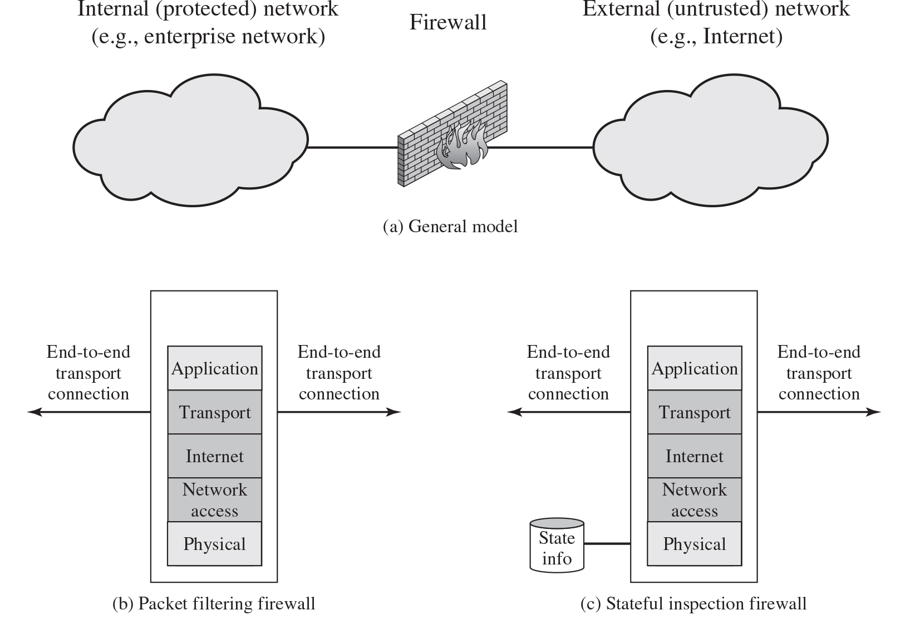
Figure 9.1 Types of Firewalls
Notes:
A firewall can monitor network traffic at a number of levels, from low-level network packets, either individually or as part of a flow, to all traffic within a transport connection, up to inspecting details of application protocols. The choice of which level is appropriate is determined by the desired firewall access policy. It can operate as a positive filter, allowing to pass only packets that meet specific criteria, or as a negative filter, rejecting any packet that meets certain criteria. The criteria implement the access policy for the firewall that we discussed in the previous section. Depending on the type of firewall, it may examine one or more protocol headers in each packet, the payload of each packet, or the pattern generated by a sequence of packets. In this section, we look at the principal types of firewalls. The illustrations are as follows. Illustration a labeled, general model, depicts a firewall which is placed between Internal, protected, network, example enterprise network and external, untrusted, network, example internet. Illustration b labeled, packet filtering firewall depicts a firewall with five layers from bottom to top as follows. Physical, Network access, internet, transport, application. The firewall has end to end transport connection on both sides. Illustration c labeled, stateful inspection firewall depicts a firewall with five layers from bottom to top as follows. Physical, Network access, internet, transport, application. A state info is connected to the firewall. The firewall has end to end transport connection on both sides. Illustration d labeled, application proxy firewall depicts a firewall with two sets of five layers. The layers from bottom to top are as follows. Physical, Network access, internet, transport, application. The two application layers are connected to the each other, and the connection is labeled, application proxy. The transport layer in the first set is connected to the internal transport connection, while the transport layer in the second set is connected to the external transport connection. Illustration e labeled, circuit level proxy firewall depicts a firewall with two sets of five layers. The layers from bottom to top are as follows. Physical, Network access, internet, transport, application. The two transport layers are connected to the each other, and the connection is labeled, circuit level proxy. The transport layer in the first set is connected to the internal transport connection, while the transport layer in the second set is connected to the external transport connection.

Slide 9
Packet Filtering Firewall
Applies rules to each incoming and outgoing I P packet
Typically a list of rules based on matches in the I P or T C P header
Forwards or discards the packet based on rules match
Filtering rules are based on information contained in a network packet
Source I P address
Destination I P address
Source and destination transport-level address
I P protocol field
Interface
Two default policies:
Discard - prohibit unless expressly permitted
More conservative, controlled, visible to users
Forward - permit unless expressly prohibited
Easier to manage and use but less secure
Notes:
A packet filtering firewall applies a set of rules to each incoming and outgoing IP packet and then forwards or discards the packet ( Figure 9.1b ). The firewall is typically configured to filter packets going in both directions (from and to the internal network). Filtering rules are based on information contained in a network packet:
• Source IP address: The IP address of the system that originated the IP packet (e.g., 192.178.1.1)
• Destination IP address: The IP address of the system the IP packet is trying to reach (e.g., 192.168.1.2)
• Source and destination transport-level address: The transport-level (e.g., TCP or UDP) port number, which defines applications such as SNMP or HTTP.
• IP protocol field: Defines the transport protocol
• Interface: For a firewall with three or more ports, which interface of the firewall the packet came from or for which interface of the firewall the packet is destined.
The packet filter is typically set up as a list of rules based on matches to fields in the IP or TCP header. If there is a match to one of the rules, that rule is invoked to determine whether to forward or discard the packet. If there is no match to any rule, then a default action is taken. Two default policies are possible:
• Default = discard: That which is not expressly permitted is prohibited.
• Default = forward: That which is not expressly prohibited is permitted.
The default discard policy is more conservative. Initially, everything is blocked, and services must be added on a case-by-case basis. This policy is more visible to users, who are more likely to see the firewall as a hindrance. However, this is the policy likely to be preferred by businesses and government organizations. Further, visibility to users diminishes as rules are created. The default forward policy increases ease of use for end users but provides reduced security; the security administrator must, in essence, react to each new security threat as it becomes known. This policy may be used by generally more open organizations, such as universities.

Slide 10
Table 9.1 Packet-Filtering Examples
Rule | Direction | S r c address | Dest addresss | Protocol | Dest port | Action
1 | In | External | Internal | T C P | 25 | Permit
2 | Out | Internal | External | T C P | >1023 | Permit
3 | Out | Internal | External | T C P | 25 | Permit
4 | In | External | Internal | T C P | >1023 | Permit
5 | Either | Any | Any | Any | Any | Deny
Notes:
Table 9.1 is a simplified example of a rule set for SMTP traffic. The goal is to allow inbound and outbound email traffic but to block all other traffic. The rules are applied top to bottom to each packet. The intent of each rule is:
1. Inbound mail from an external source is allowed (port 25 is for SMTP incoming).
2. This rule is intended to allow a response to an inbound SMTP connection.
3. Outbound mail to an external source is allowed.
4. This rule is intended to allow a response to an inbound SMTP connection.
5. This is an explicit statement of the default policy. All rule sets include this rule implicitly as the last rule.
There are several problems with this rule set. Rule 4 allows external traffic to any destination port above 1023. As an example of an exploit of this rule, an external attacker can open a connection from the attacker’s port 5150 to an internal Web proxy server on port 8080. This is supposed to be forbidden and could allow an attack on the server. To counter this attack, the firewall rule set can be configured with a source port field for each row. For rules 2 and 4, the source port is set to 25; for rules 1 and 3, the source port is set to >1023.
But a vulnerability remains. Rules 3 and 4 are intended to specify that any inside host can send mail to the outside. A TCP packet with a destination port of 25 is routed to the SMTP server on the destination machine. The problem with this rule is that the use of port 25 for SMTP receipt is only a default; an outside machine could be configured to have some other application linked to port 25. As the revised rule 4 is written, an attacker could gain access to internal machines by sending packets with a TCP source port number of 25. To counter this threat, we can add an ACK flag field to each row. For rule 4, the field would indicate that the ACK flag must be set on the incoming packet. Rule 4 would now look like this:
Rule 4
Direction In
Src address External
Src port 25
Dest address Internal
Protocol TCP
Dest port >1023
Flag ACK
Action. Permit
The rule takes advantage of a feature of TCP connections. Once a connection is set up, the ACK flag of a TCP segment is set to acknowledge segments sent from the other side. Thus, this rule allows incoming packets with a source port number of 25 that include the ACK flag in the TCP segment.

Slide 11
Packet Filter Advantages And Weaknesses
Advantages
Simplicity
Typically transparent to users and are very fast
Weaknesses
Cannot prevent attacks that employ application specific vulnerabilities or functions
Limited logging functionality
Do not support advanced user authentication
Vulnerable to attacks on T C P/I P protocol bugs
Improper configuration can lead to breaches
Notes:
One advantage of a packet filtering firewall is its simplicity. Also, packet filters typically are transparent to users and are very fast. NIST SP 800-41 lists the following weaknesses of packet filter firewalls:
• Because packet filter firewalls do not examine upper-layer data, they cannot prevent attacks that employ application-specific vulnerabilities or functions. For example, a packet filter firewall cannot block specific application commands; if a packet filter firewall allows a given application, all functions available within that application will be permitted.
• Because of the limited information available to the firewall, the logging functionality present in packet filter firewalls is limited. Packet filter logs normally contain the same information used to make access control decisions (source address, destination address, and traffic type).
• Most packet filter firewalls do not support advanced user authentication schemes. Once again, this limitation is mostly due to the lack of upper-layer functionality by the firewall.
• Packet filter firewalls are generally vulnerable to attacks and exploits that take advantage of problems within the TCP/IP specification and protocol stack, such as network layer address spoofing . Many packet filter firewalls cannot detect a network packet in which the OSI Layer 3 addressing information has been altered. Spoofing attacks are generally employed by intruders to bypass the security controls implemented in a firewall platform.
• Finally, due to the small number of variables used in access control decisions, packet filter firewalls are susceptible to security breaches caused by improper configurations. In other words, it is easy to accidentally configure a packet filter firewall to allow traffic types, sources, and destinations that should be denied based on an organization’s information security policy.
Some of the attacks that can be made on packet filtering firewalls and the appropriate countermeasures are the following:
• IP address spoofing : The intruder transmits packets from the outside with a source IP address field containing an address of an internal host. The attacker hopes that the use of a spoofed address will allow penetration of systems that employ simple source address security, in which packets from specific trusted internal hosts are accepted. The countermeasure is to discard packets with an inside source address if the packet arrives on an external interface. In fact, this countermeasure is often implemented at the router external to the firewall.
• Source routing attacks: The source station specifies the route that a packet should take as it crosses the Internet, in the hopes that this will bypass security measures that do not analyze the source routing information. A countermeasure is to discard all packets that use this option.
• Tiny fragment attacks: The intruder uses the IP fragmentation option to create extremely small fragments and force the TCP header information into a separate packet fragment. This attack is designed to circumvent filtering rules that depend on TCP header information. Typically, a packet filter will make a filtering decision on the first fragment of a packet. All subsequent fragments of that packet are filtered out solely on the basis that they are part of the packet whose first fragment was rejected. The attacker hopes that the filtering firewall examines only the first fragment and that the remaining fragments are passed through. A tiny fragment attack can be defeated by enforcing a rule that the first fragment of a packet must contain a predefined minimum amount of the transport header. If the first fragment is rejected, the filter can remember the packet and discard all subsequent fragments.

Slide 12
Stateful Inspection Firewall
Tightens rules for T C P traffic by creating a directory of outbound T C P connections
There is an entry for each currently established connection
Packet filter allows incoming traffic to high numbered ports only for those packets that fit the profile of one of the entries in this directory
Reviews packet information but also records information about T C P connections
Keeps track of T C P sequence numbers to prevent attacks that depend on the sequence number
Inspects data for protocols like F T P, I M and S I P S commands
Notes:
A traditional packet filter makes filtering decisions on an individual packet basis and does not take into consideration any higher-layer context. To understand what is meant by context and why a traditional packet filter is limited with regard to context, a little background is needed. Most standardized applications that run on top of TCP follow a client/server model. For example, for the Simple Mail Transfer
Protocol (SMTP), e-mail is transmitted from a client system to a server system. The client system generates new e-mail messages, typically from user input. The server system accepts incoming e-mail messages and places them in the appropriate user mailboxes. SMTP operates by setting up a TCP connection between client and server, in which the TCP server port number, which identifies the SMTP server
application, is 25. The TCP port number for the SMTP client is a number between 1024 and 65535 that is generated by the SMTP client.
In general, when an application that uses TCP creates a session with a remote host, it creates a TCP connection in which the TCP port number for the remote (server) application is a number less than 1024 and the TCP port number for the local (client) application is a number between 1024 and 65535. The numbers less than 1024 are the “well-known” port numbers and are assigned permanently to particular applications (e.g., 25 for server SMTP). The numbers between 1024 and 65535 are generated dynamically and have temporary significance only for the
lifetime of a TCP connection.
A simple packet filtering firewall must permit inbound network traffic on all these high-numbered ports for TCP-based traffic to occur. This creates a vulnerability that can be exploited by unauthorized users.

Slide 13
Table 9.2 Example Stateful Firewall Connection State Table
Source Address | Source Port | Destination Address | Destination Port | Connection State
192.168.1.100 | 1030 | 210.9.88.29 | 80 | Established
192.168.1.102 | 1031 | 216.32.42.123 | 80 | Established
192.168.1.101 | 1033 | 173.66.32.122 | 25 | Established
192.168.1.106 | 1035 | 177.231.32.12 | 79 | Established
223.43.21.231 | 1990 | 192.168.1.6 | 80 | Established
219.22.123.32 | 2112 | 192.168.1.6 | 80 | Established
210.99.212.18 | 3321 | 192.168.1.6 | 80 | Established
24.102.32.23 | 1025 | 192.168.1.6 | 80 | Established
223.21.22.12 | 1046 | 192.168.1.6 | 80 | Established
Notes:
A stateful inspection packet firewall tightens up the rules for TCP traffic by creating a directory of outbound TCP connections, as shown in Table 9.2 . There is an entry for each currently established connection. The packet filter will now allow incoming traffic to high-numbered ports only for those packets that fit the profile of one of the entries in this directory.
A stateful packet inspection firewall reviews the same packet information as a packet filtering firewall, but also records information about TCP connections (Figure 9.1c). Some stateful firewalls also keep track of TCP sequence numbers to prevent attacks that depend on the sequence number, such as session hijacking. Some even inspect limited amounts of application data for some well-known protocols like FTP, IM, and SIPS commands, in order to identify and track related connections.

Slide 14
Host-Based Firewalls
Used to secure an individual host
Available in operating systems or can be provided as an add-on package
Filter and restrict packet flows
Common location is a server
Advantages:
Filtering rules can be tailored to the host environment
Protection is provided independent of topology
Provides an additional layer of protectiona
Notes:
A host-based firewall is a software module used to secure an individual host. Such modules are available in many operating systems or can be provided as an add-on package. Like conventional stand-alone firewalls, host-resident firewalls filter and restrict the flow of packets. A common location for such firewalls is a server. There are several advantages to the use of a server-based or workstation-based firewall:
• Filtering rules can be tailored to the host environment. Specific corporate security policies for servers can be implemented, with different filters for servers used for different application.
• Protection is provided independent of topology. Thus both internal and external attacks must pass through the firewall.
• Used in conjunction with stand-alone firewalls, the host-based firewall provides an additional layer of protection. A new type of server can be added to the network, with its own firewall, without the necessity of altering the network firewall configuration.

Slide 15
Personal Firewall
Controls traffic between a personal computer or workstation and the Internet or enterprise network
For both home or corporate use
Typically is a software module on a personal computer
Can be housed in a router that connects all of the home computers to a D S L, cable modem, or other Internet interface
Typically much less complex than server-based or stand-alone firewalls
Primary role is to deny unauthorized remote access
May also monitor outgoing traffic to detect and block worms and malware activity
Notes:
A personal firewall controls the traffic between a personal computer or workstation on one side and the Internet or enterprise network on the other side. Personal firewall functionality can be used in the home environment and on corporate intranets. Typically, the personal firewall is a software module on the personal computer. In a home environment with multiple computers connected to the Internet, firewall
functionality can also be housed in a router that connects all of the home computers to a DSL, cable modem, or other Internet interface.
Personal firewalls are typically much less complex than either server-based firewalls or stand-alone firewalls. The primary role of the personal firewall is to deny unauthorized remote access to the computer. The firewall can also monitor outgoing activity in an attempt to detect and block worms and other malware.
Personal firewall capabilities are provided by the netfilter package on Linux systems, or the pf package on BSD and Mac OS systems, or by the Windows Firewall. These packages may be configured on the command-line, or with a GUI front-end. When such a personal firewall is enabled, all inbound connections are usually denied except for those the user explicitly permits. Outbound connections are usually allowed. The list of inbound services that can be selectively re-enabled, with their port numbers, may include the following common services:
• Personal file sharing (548, 427)
• Windows sharing (139)
• Personal Web sharing (80, 427)
• Remote login—SSH (22)
• FTP access (20-21, 1024-65535 from 20-21)
• Printer sharing (631, 515)
• IChat Rendezvous (5297, 5298)
• ITunes Music Sharing (3869)
CVS (2401)
• Gnutella/Limewire (6346)
• ICQ (4000)
• IRC (194)
• MSN Messenger (6891-6900)
• Network Time (123)
• Retrospect (497)
• SMB (without netbios–445)
• VNC (5900-5902)
• WebSTAR Admin (1080, 1443)
When FTP access is enabled, ports 20 and 21 on the local machine are opened for FTP; if others connect to this computer from ports 20 or 21, the ports 1024 through 65535 are open.
For increased protection, advanced firewall features may be configured. For example, stealth mode hides the system on the Internet by dropping unsolicited communication packets, making it appear as though the system is not present. UDP packets can be blocked, restricting network traffic to TCP packets only for open ports. The firewall also supports logging, an important tool for checking on unwanted activity. Other types of personal firewall allow the user to specify that only selected applications, or applications signed by a valid certificate authority,
may provide services accessed from the network.

Slide 16
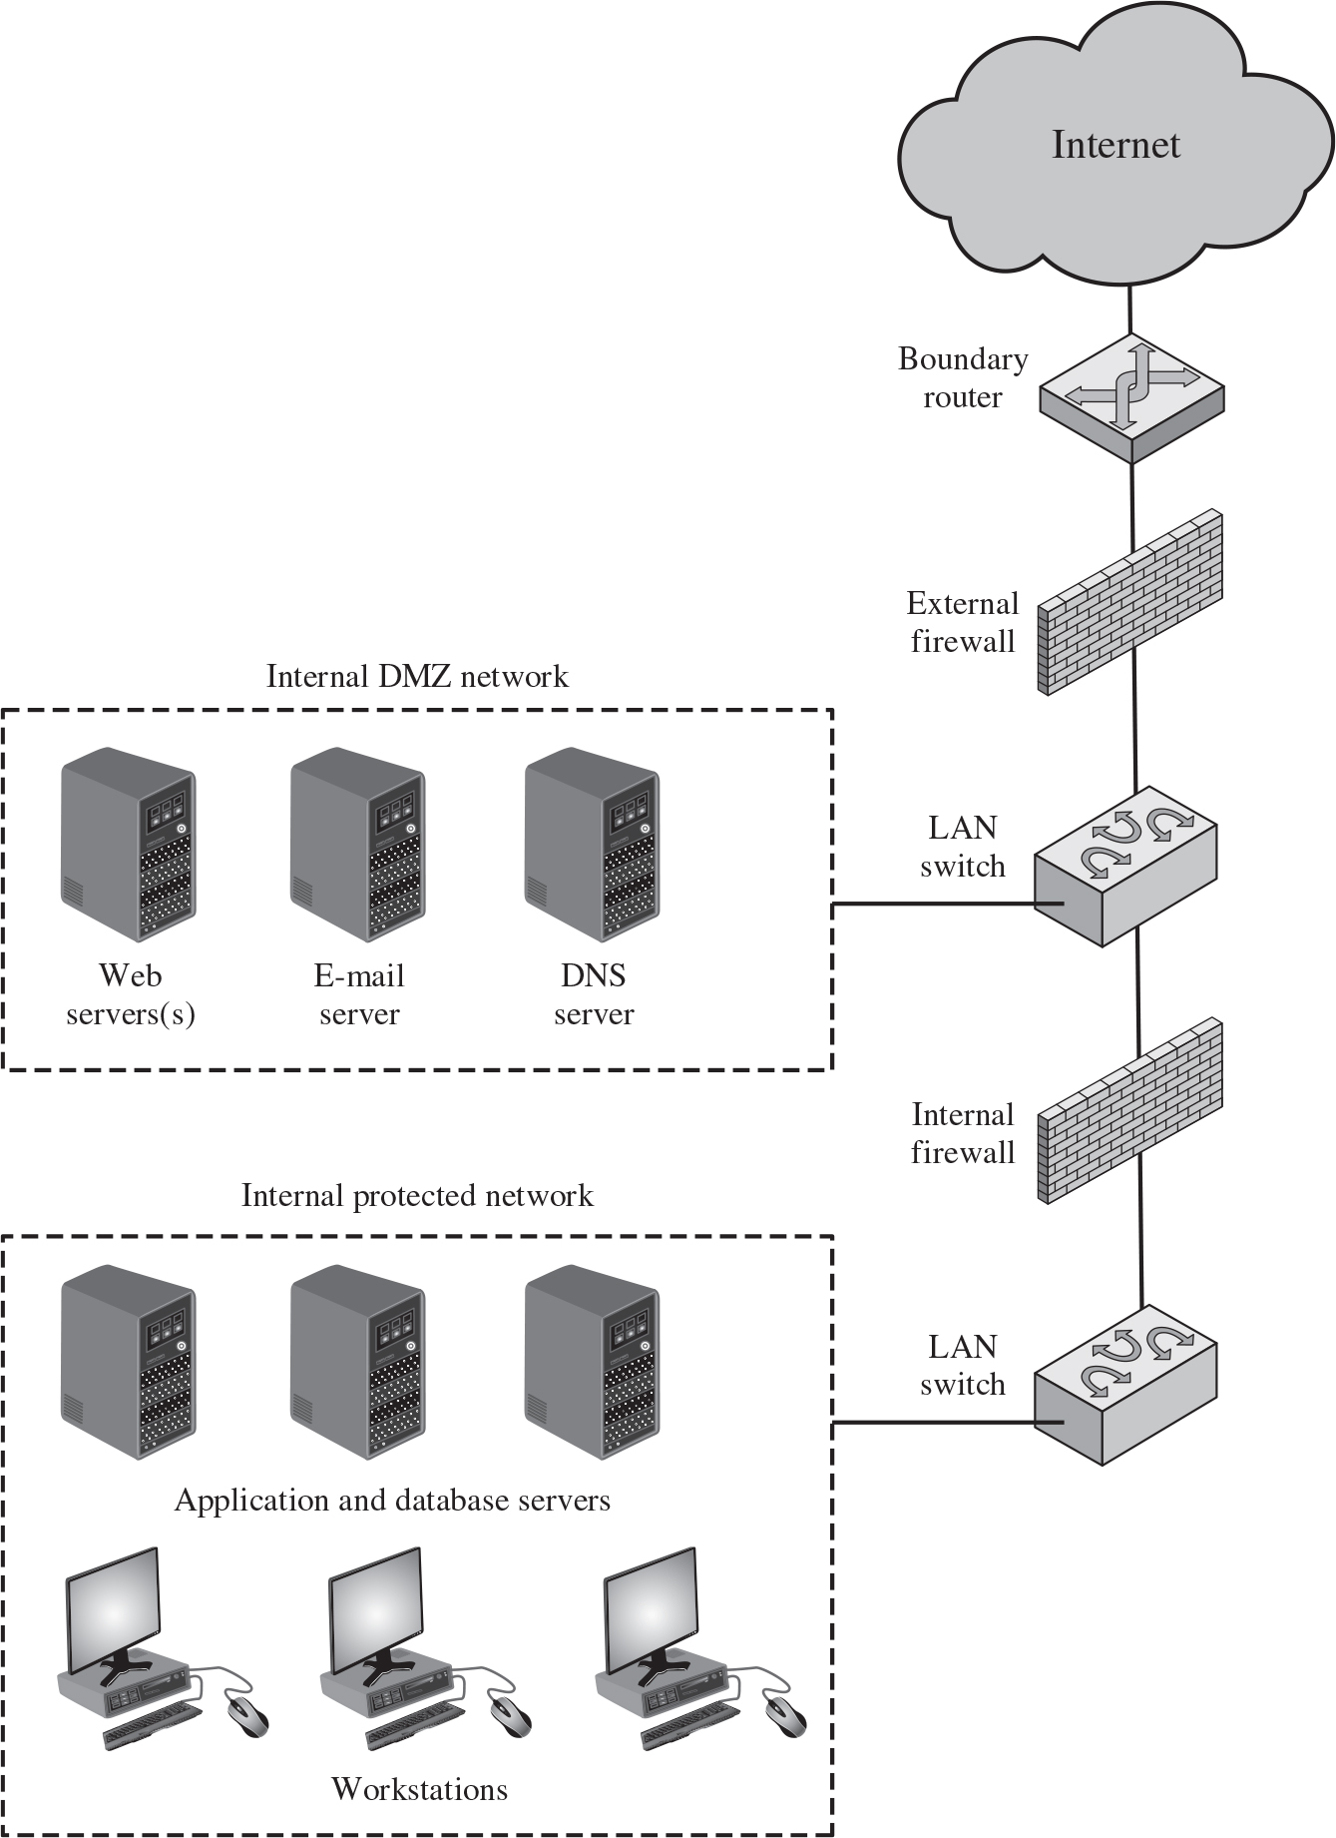
Figure 9.2 Example Firewall Configuration
Notes:
Figure 9.2 illustrates a common firewall configuration that includes an additional network segment between an internal and an external firewall (see also Figure 8.5). An external firewall is placed at the edge of a local or enterprise network, just inside the boundary router that connects to the Internet or some wide area network (WAN). One or more internal firewalls protect the bulk of the enterprise network.
Between these two types of firewalls are one or more networked devices in a region referred to as a DMZ (demilitarized zone) network. Systems that are externally accessible but need some protections are usually located on DMZ networks. Typically, the systems in the DMZ require or foster external connectivity, such as a corporate Web site, an e-mail server, or a DNS (domain name system) server.
The external firewall provides a measure of access control and protection for the DMZ systems consistent with their need for external connectivity. The external firewall also provides a basic level of protection for the remainder of the enterprise network. In this type of configuration, internal firewalls serve three purposes:
1. The internal firewall adds more stringent filtering capability, compared to the external firewall, in order to protect enterprise servers and workstations from external attack.
2. The internal firewall provides two-way protection with respect to the DMZ. First, the internal firewall protects the remainder of the network from attacks launched from DMZ systems. Such attacks might originate from worms, rootkits, bots, or other malware lodged in a DMZ system. Second, an internal firewall can protect the DMZ systems from attack from the internal protected network.
3. Multiple internal firewalls can be used to protect portions of the internal network from each other. Figure 8.5 (Example of NIDS Sensor Deployment) shows a configuration in which the internal servers are protected from internal workstations and vice versa. It also illustrates the common practice of placing the DMZ on a different network interface on the external firewall from that used to access the internal networks. The internal protected network consisting of workstations along with the application and database servers is connected to a LAN switch. The internal D M Z network consisting of Web servers, e mail server, and D N S server is connected to another LAN switch. The two LAN switches are connected by an internal firewall. The internal D M Z network LAN switch is then connected to a boundary router through an external firewall. The router is then connected to the internet.

Slide 17
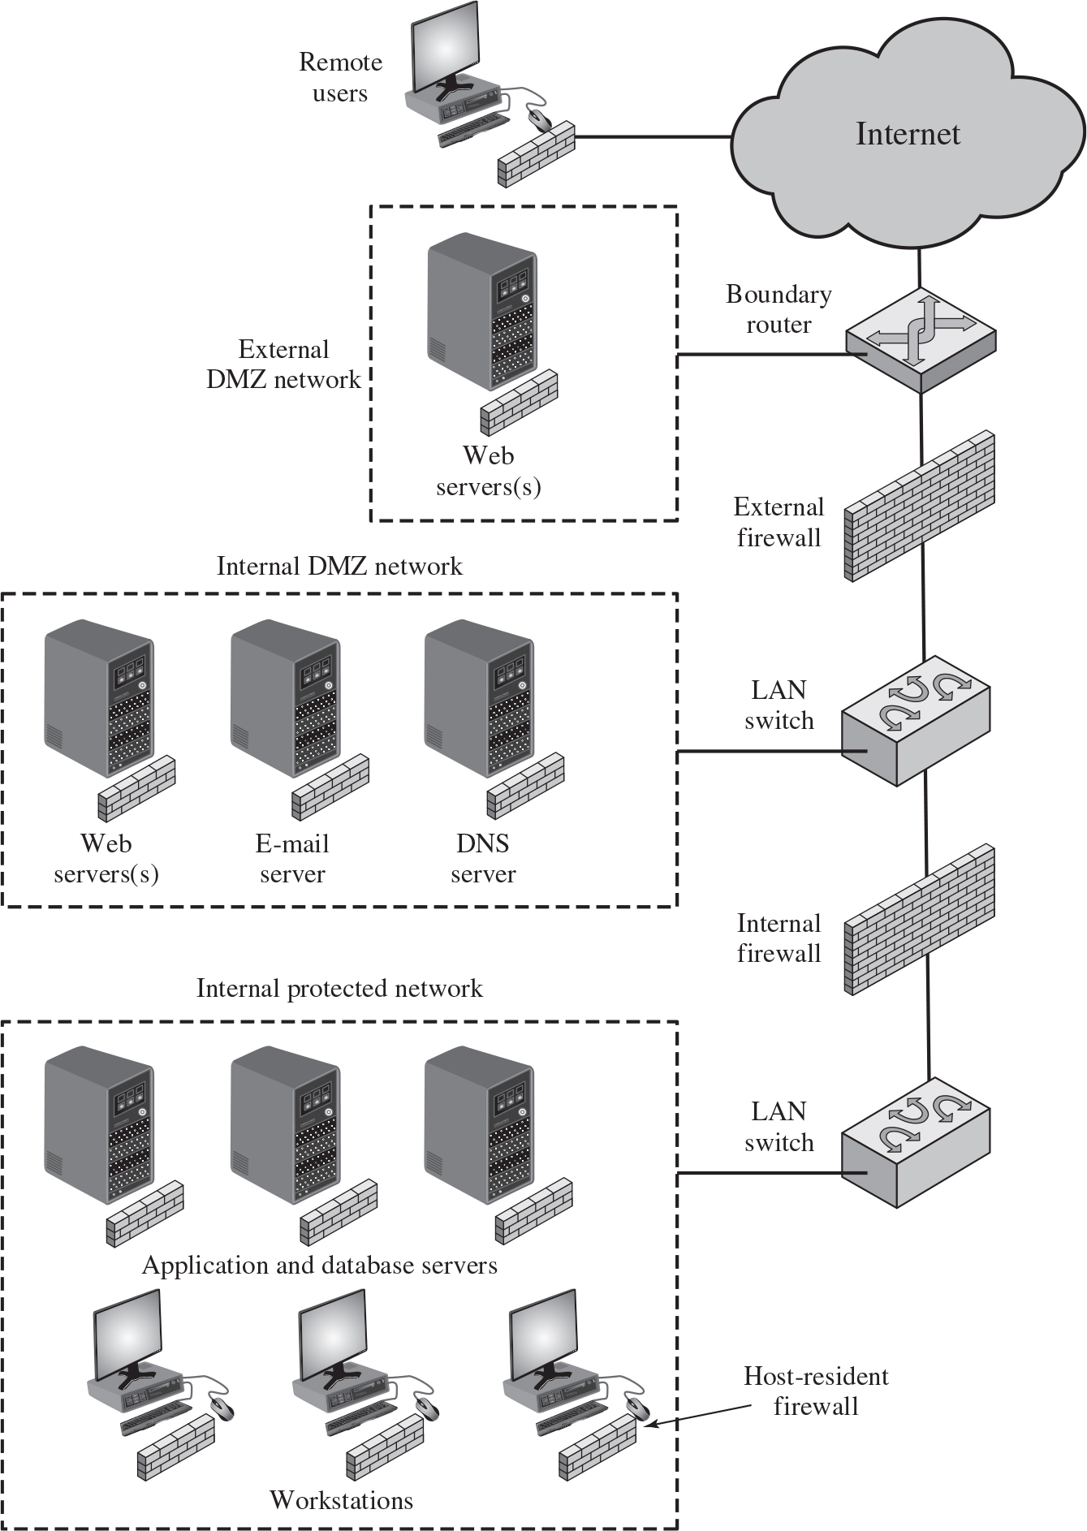
Figure 9.4 Example Distributed Firewall Configuration
Notes:
A distributed firewall configuration involves stand-alone firewall devices plus host-based firewalls working together under a central administrative control. Figure 9.4 suggests a distributed firewall configuration. Administrators can configure host resident firewalls on hundreds of servers and workstation as well as configure personal firewalls on local and remote user systems. Tools let the network administrator set policies and monitor security across the entire network. These firewalls protect against internal attacks and provide protection tailored to specific machines and applications. Stand-alone firewalls provide global protection, including internal firewalls and an external firewall, as discussed previously.
With distributed firewalls, it may make sense to establish both an internal and an external DMZ. Web servers that need less protection because they have less critical information on them could be placed in an external DMZ, outside the external firewall. What protection is needed is provided by host-based firewalls on these servers.
An important aspect of a distributed firewall configuration is security monitoring. Such monitoring typically includes log aggregation and analysis, firewall statistics, and fine-grained remote monitoring of individual hosts if needed. The internal protected network consisting of workstations along with the application and database servers, with host resistant firewall, is connected to a LAN switch. The internal D M Z network consisting of Web servers, email server, and D N S server is connected to another LAN switch. The two LAN switches are connected by an internal firewall. The internal D M Z network LAN switch is then connected to a boundary router through an external firewall. The router is then connected to the internet. The boundary router is connected to an external D M Z network and the internet is connected to remote users.

Slide 18
Intrusion Prevention Systems (I P S)
Also known as Intrusion Detection and Prevention System (I D P S)
Is an extension of an I D S that includes the capability to attempt to block or prevent detected malicious activity
Can be host-based, network-based, or distributed/hybrid
Can use anomaly detection to identify behavior that is not that of legitimate users, or signature/heuristic detection to identify known malicious behavior can block traffic as a firewall does, but makes use of the types of algorithms developed for I D Ss to determine when to do so
Notes:
A further addition to the range of security products is the intrusion prevention system (IPS), also known as intrusion detection and prevention system (IDPS). It is an extension of an IDS that includes the capability to attempt to block or prevent detected malicious activity. Like an IDS, an IPS can be host-based, network-based, or distributed/hybrid, as we discuss in Chapter 8. Similarly, it can use anomaly
detection to identify behavior that is not that of legitimate users, or signature/heuristic detection to identify known malicious behavior.
Once an IDS has detected malicious activity, it can respond by modifying or blocking network packets across a perimeter or into a host, or by modifying or blocking system calls by programs running on a host. Thus, a network IPS can block traffic, as a firewall does, but makes use of the types of algorithms developed for IDSs to determine when to do so. It is a matter of terminology whether a network IPS is considered a separate, new type of product or simply another form of firewall.

Slide 19

Copyright
This work is protected by United States copyright laws and is provided solely for the use of instructors in teaching their courses and assessing student learning. Dissemination or sale of any part of this work (including on the World Wide Web) will destroy the integrity of the work and is not permitted. The work and materials from it should never be made available to students except by instructors using the accompanying text in their classes. All recipients of this work are expected to abide by these restrictions and to honor the intended pedagogical purposes and the needs of other instructors who rely on these materials.

